Slide 1
X.25
WAN Technologies
Packet switched Network consisting of X.25 switches.
X.25 is a connection oriented protocol (Virtual Circuits).
End nodes are identified by an X .25 address.
Typical bandwidth offered is 2.4/9.6 kbps.
IP networks interface with X .25 through IP- X.25 routers.

Slide 2
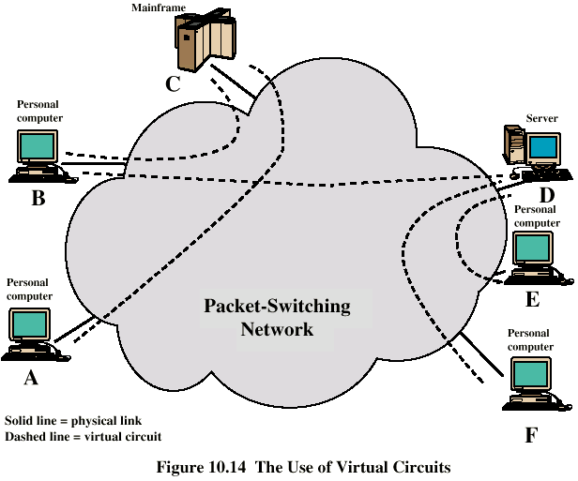
X.25 and Virtual Circuits
WAN Technologies

Slide 3
Frame Relay
WAN Technologies
Designed to be more efficient than X.25
Developed before ATM
Call control carried in separate logical connection
No hop by hop error or flow control
End to end flow and error control (if used) are done by higher layer
Single user data frame sent from source to destination and ACK (from higher layer) sent back
Two type of Virtual Circuits defined
  Permanent virtual circuits (PVCs)
  Switched virtual circuits (SVCs)

Slide 4
ATM
WAN Technologies
Small fixed size packets of 53 bytes, called cells, are used for transferring information.
Each cell has 5 bytes of header and 48 bytes of payload for user information.
Connection oriented protocol.
A virtual Circuit is established between the communicating nodes before data transfer takes place.
Can be seamlessly used in LANs and WANs.
Almost unlimited scalability.
Provides quality of service guaranties.

Slide 5
Digital Subscriber Line (DSL)
WAN Technologies
Digital Subscriber Line (DSL) uses the Ordinary Telephone line and is an always-on technology. This means there is no need to dial up each time to connect to the Internet.
Because DSL is highly dependent upon noise levels, a subscriber cannot be any more than 5.5 kilometers (2-3 miles) from the DSL Exchange
Service can be symmetric, in which downstream and upstream speeds are identical, or asymmetric in which downstream speed is faster than upstream speed.
DSL comes in several varieties:
  Asymmetric DSL (ADSL)
  High Data Rate DSL (HDSL)
  Symmetric DSL (SDSL)
  Very High Data Rate DSL (VDSL)

Slide 6
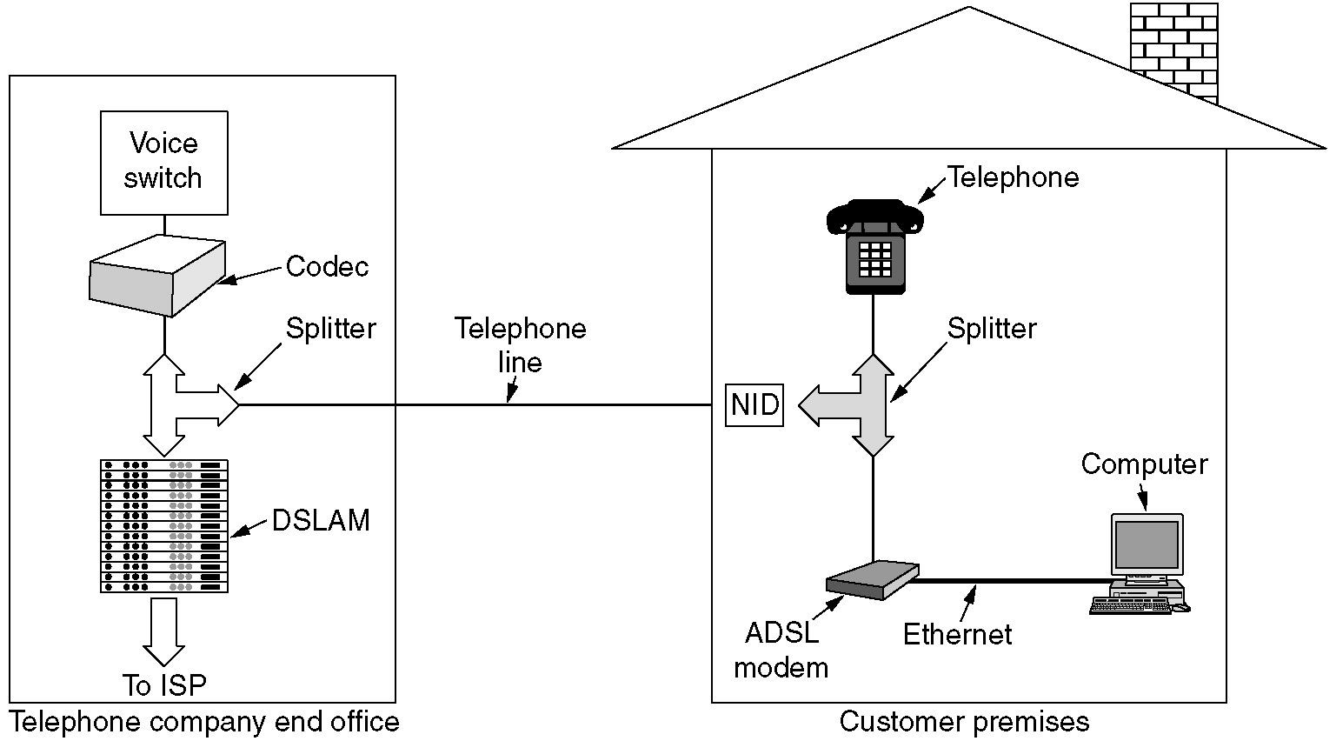
ADSL
WAN Technologies

Slide 7
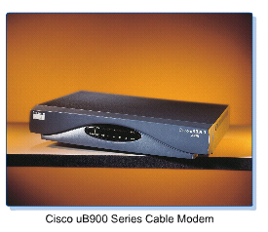
Cable Modems
WAN Technologies
The cable modem connects a computer to the cable company network through the same coaxial cabling that feeds cable TV (CATV) signals to a television set.
Uses Cable Modem at Home End and CMTS (Cable Modem Termination System) at Head End.
Characteristics:
  Shared bandwidth technology
  10 Mbps to 30 Mbps downstream
  128Kbps-3 Mbps upstream
  Maximum Distance from provider to customer site: 30 miles

Slide 8
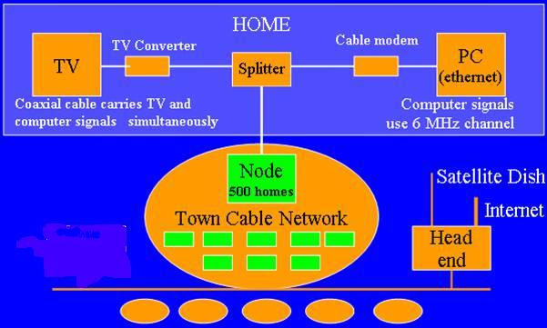
Cable Modems
WAN Technologies

Slide 9

Point-to-Point Microwave Link
WAN Technologies
MICROWAVE LINK
RF
Modem
Router
Network
Router
RF
Modem
ISP Network
CUSTOMER PREMISES
ISP PREMISES

Slide 10
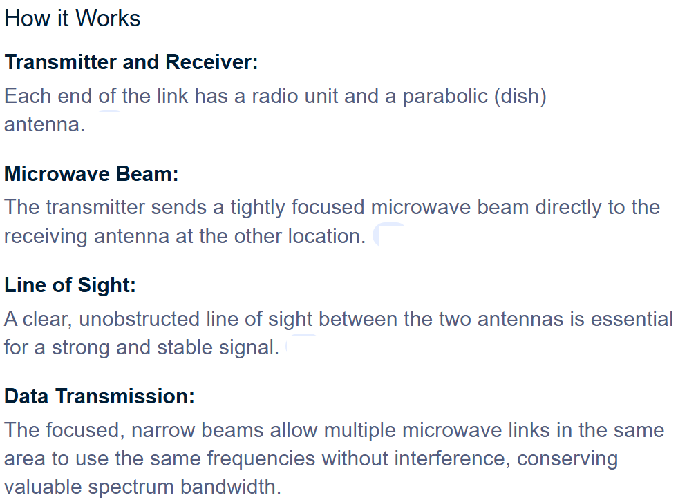

Slide 11
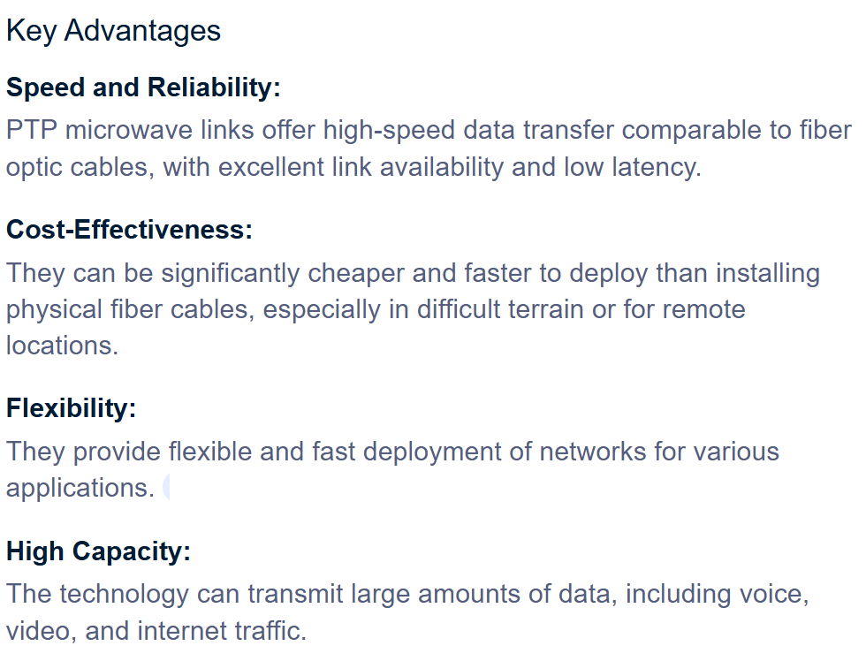

Slide 12
Point-to-Point Microwave Link
WAN Technologies
Typically 80-100 MHz Band or 5 GHz Radio Link band
2.4 GHz WiFi links are becoming popular
Requires Line of Sight

Slide 13
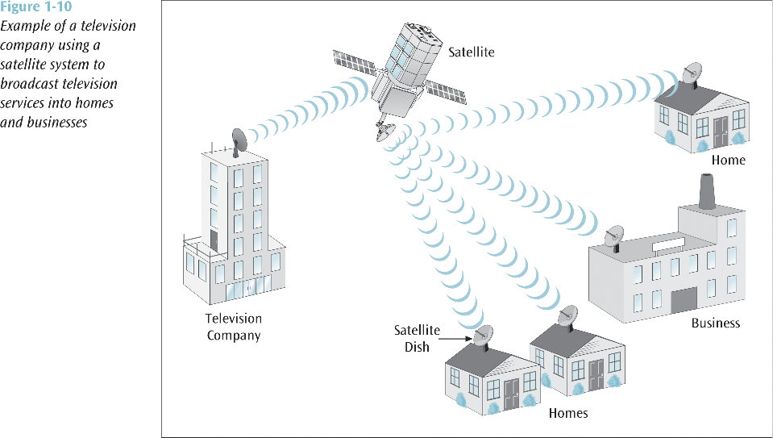
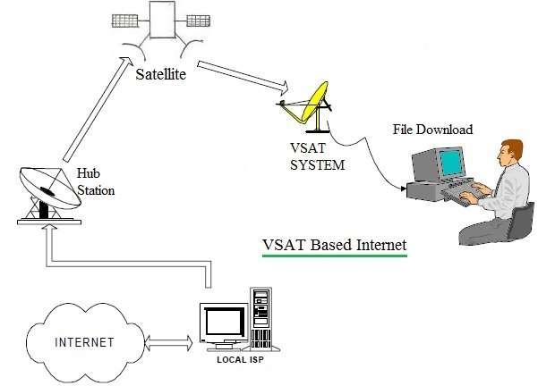
VSAT
WAN Technologies
Each satellite sends and receives over two bands
  Uplink: From the earth to the satellite
  Downlink: From the satellite to the earth
Satellite frequency bands
Band Downlink Uplink
C 3.7-4.2 GHz 5.925-6.425 GHz
Ku 11.7-12.2 GHz 14-14.5 GHz
Ku-band based networks, are used primarily in Europe and North America and utilize the smaller sizes of VSAT antennas.
C-band, used extensively in Asia, Africa and Latin America, require larger antenna.

Slide 14
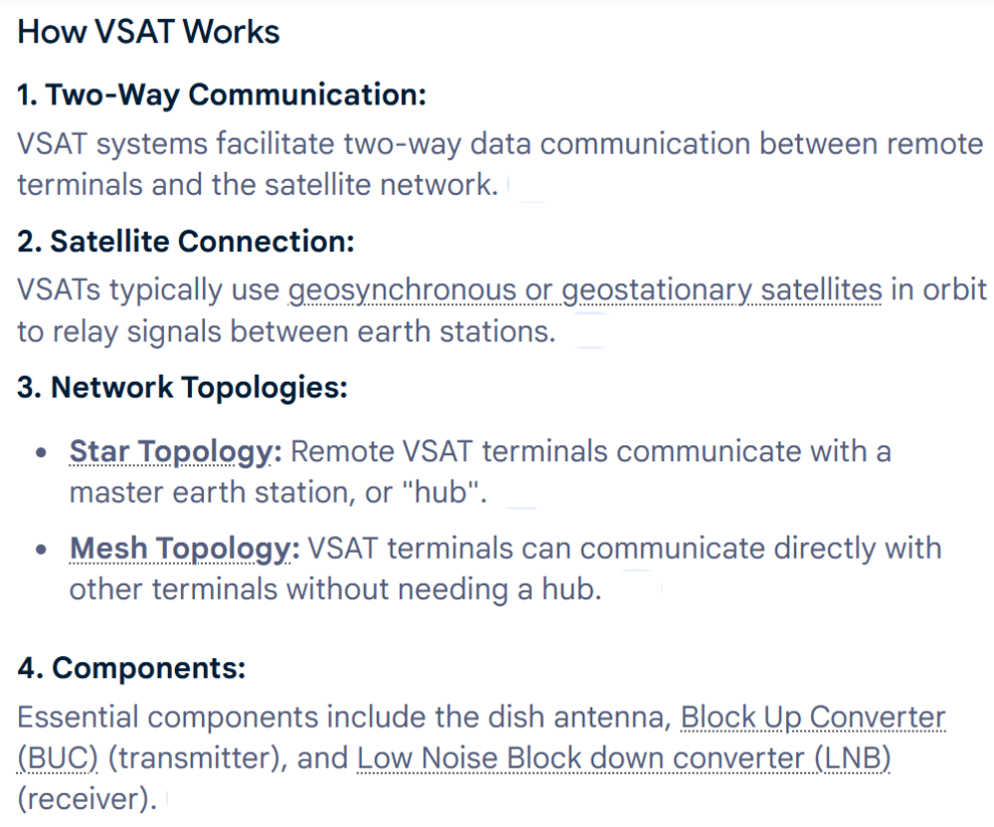
VSAT
WAN Technologies
Very Small Aperture Terminal (VSAT) provide communication between two nodes through a powerful Earth station called a Hub.
If two terminals want to communicate, they send their messages to the satellite, which sends it to the Hub and the Hub then broadcasts the message through the satellite.
Typical Bandwidth offered is 9.6/19.2/32/64/128/256/512 Kbps.
Operating modes are TDM/TDMA, SCPC PAMA & DAMA

Slide 15
VSAT
Key Features
Compact Size:
The small size of the antenna (typically 75 cm to 1.2 m) makes it suitable for user-end installations.
Reliability:
Provides dedicated and reliable communication links for critical applications.
Flexibility:
Can be installed at user ends and is effective for dedicated long-distance communication systems.
Challenges
Latency:
A significant issue due to the long distance the signal travels to and from the satellite.
Signal Quality:
Weather conditions (rain fade) and physical obstructions can degrade signal quality.

